Slide 1
Milk to cheese process
And how automation fit into it…

Slide 2
Presented by
1- Muhammad Alaa Elghazali | 163
2-Muhammad Hassan Muhammad | 141
3- Akram Tarek Abo asl | 42
4-Mostafa Gamal | 188
5- Muhammad Arafa Muhammad | 162

Slide 3
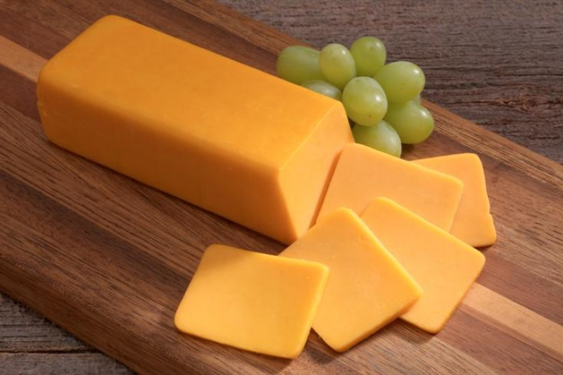
How can we make cheese ?

Slide 4
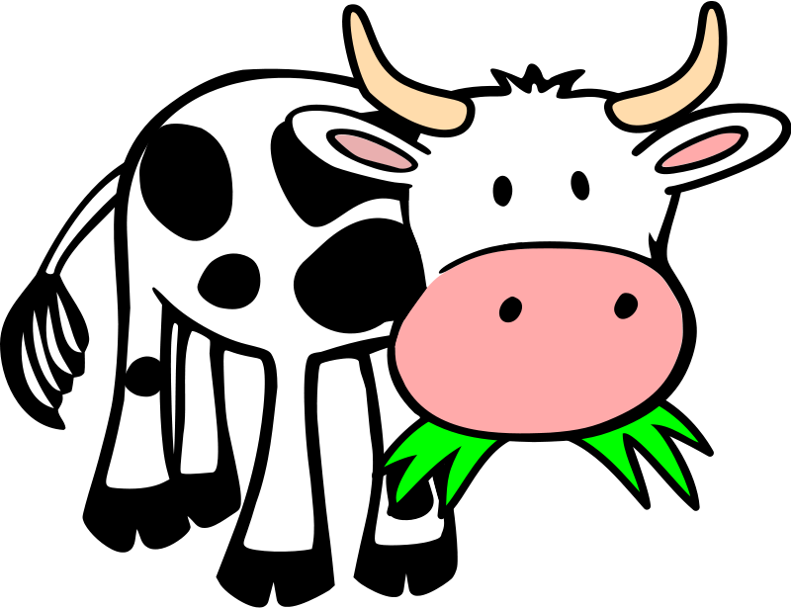
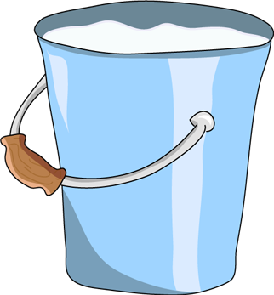

Starting with the milking process.
Cattles of Cows are milked in ranches to get milk that will be used in the cheese process later

Slide 5
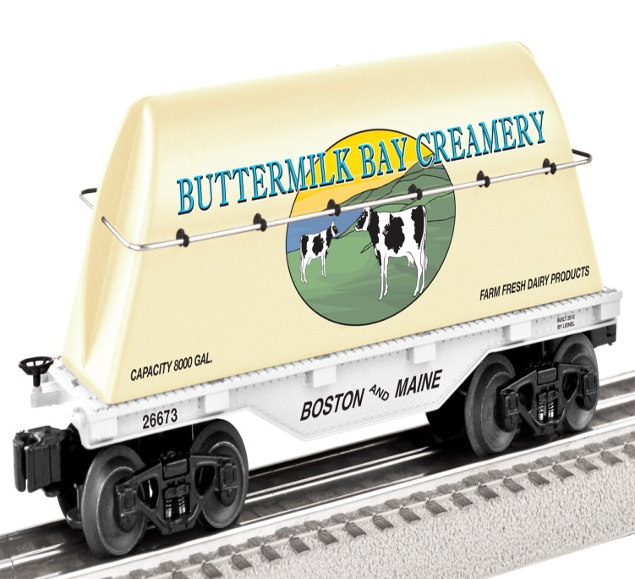
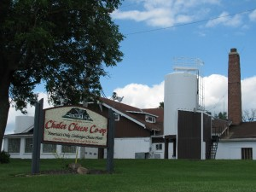

Starting with the milking process.
Milk is being moved in tank cars to the cheese production factories

Slide 6
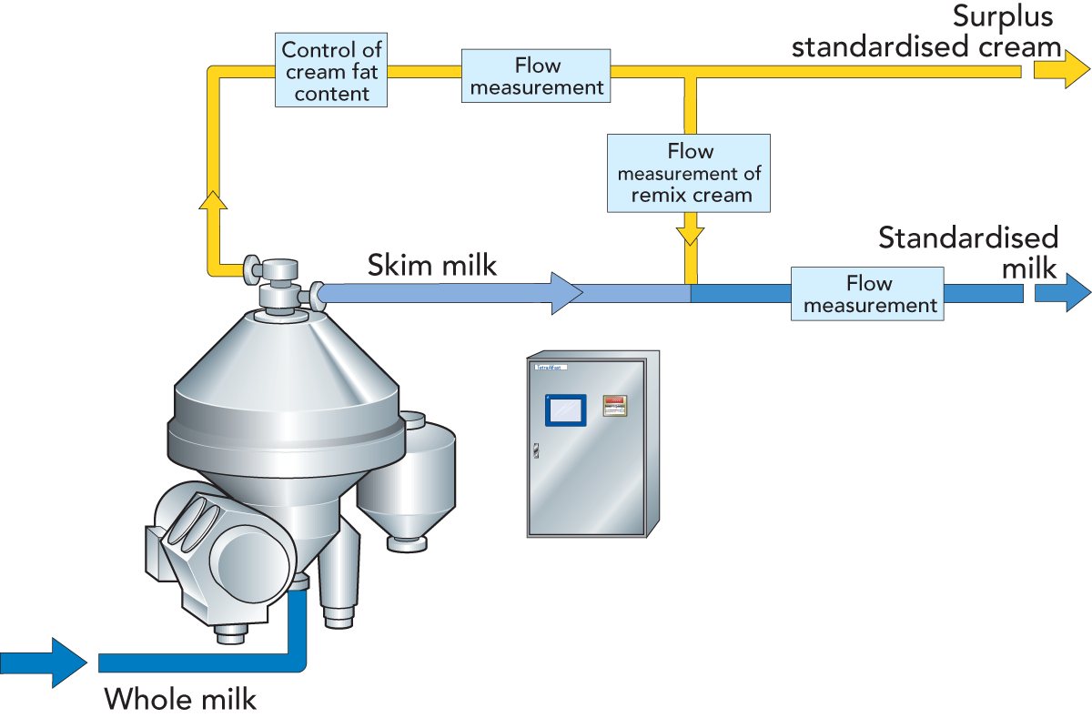
Inside the factory
1. Standardization of Milk
Milk is often standardized before cheese making to optimize the protein to fat ratio to make a good quality cheese with a high yield

Slide 7
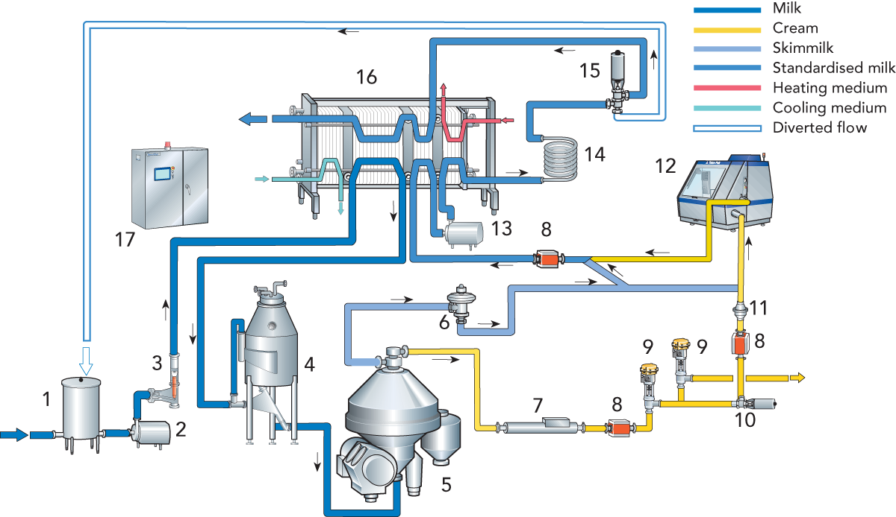
Inside the factory
2- pasteurization of milk (heating)
the milk is then pasteurized or mildly heat-treated to reduce the number of spoilage organisms at 70~73˚C

Slide 8
Inside the factory
2- pasteurization of milk (cooling)
the milk is then cooled to 32°C to bring it to the temperature needed for the starter bacteria to grow.

Slide 9
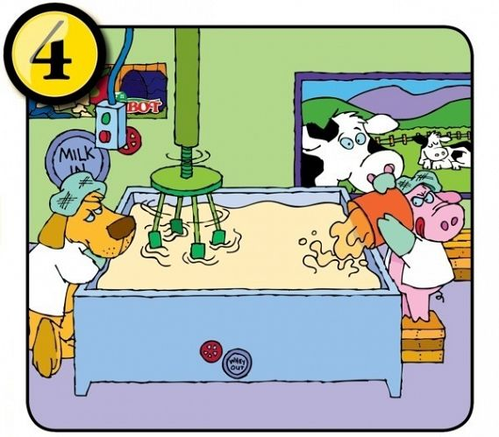
Inside the factory
3- Inoculate with Starter Bacteria and Ripen
bacteria are added to the milk and held at 32°C for 30 minutes to ripen. The ripening step allows the
bacteria to grow and begin fermentation to develop the flavor of the cheese.
4- Add Rennet and Form Curd
The rennet is the enzyme that acts on the milk proteins to form the curd. After the rennet is added,
the curd is not disturbed for approximately 30 minutes
5- Cut Curd and Heat
the curd is cut with cheese knives into
small pieces and heated to 38°C
The heating step helps to separate
the whey from the curd.
6- Drain whey
The whey is drained from the vat and
the curd forms a mat.

Slide 10
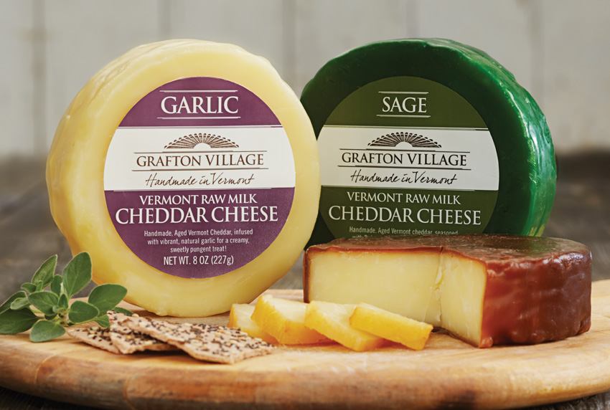
Inside the factory
7- Texture curd
The curd mats are cut into sections and piled on top of each other and flipped periodically.
This step is called cheddaring.
8- Dry Salt
For cheddar cheese, the smaller, milled curd pieces are put back in the vat and salted by sprinkling dry salt on the curd and mixing in the salt
9- Form Cheese into Blocks
10- Store

Slide 11
Thanks…

